Slide 1

Lecture 6
Software Design and Architecture
Rana Taimur Khan
Lecturer GCUF

Slide 2
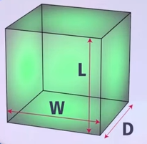
Object Orientation Basic Concepts Abstract Classes and Interfaces
Abstract Class:
We might know the specifications for a class, but might not have the information needed to implement.

Slide 3
Object Orientation Basic Concepts Abstract Classes and Interfaces
In such cases we can implement a class partially using what we called abstract classes.
Abstract class provides a basic information that other classes can inherit from.
An instance of the abstract class cannot be created.

Slide 4
Object Orientation Basic Concepts Abstract Classes and Interfaces
Interface:
A mechanism to achieve abstraction.
A collection of abstract methods.
No state or implementation.

Slide 5
Object Orientation Basic Concepts Abstract Classes and Interfaces
Interface vs Abstract Class:
Interface:
A class that implements an interface must provide an implementation of all the methods of that interface.
Interface can have no state or implementation

Slide 6
Object Orientation Basic Concepts Abstract Classes and Interfaces
Abstract Class:
Abstract classes can be inherited without implementing the abstract methods.
Abstract classes may contain state.
In general terms, the differences are not necessarily well-defined between an interface and abstract class.

Slide 7
Relationship Basic Concepts Object Oriented Programming Defined

Slide 8

Relationship Basic Concepts Object Oriented Programming Defined
Object Oriented Programming by Grady Booch:
A method of implementation in which programs are organized as cooperative collections of objects, each of which represents an instance of some class, and whose classes are all members of a hierarchy of classes united via inheritance relationship.

Slide 9
Relationship Basic Concepts Object Oriented Programming Defined
2 Key Concepts:
1. Hierarchy of classes
Here we talk about inheritance relationships among classes.
2. Cooperative Collections of Objects:
Association-relationship among instances of classes.

Slide 10
Relationship Basic Concepts Association
Association:
An association is a relationship among two or more specified classifiers that describes connections among their instances.
Associations are the “glue” that holds a system together.
Without associations, there is only a set of unconnected classes.

Slide 11
Relationship Basic Concepts Association
Types of Association:
Uses Relationship:
Simple Association
Whole-Part Relationship
Aggregation
Composition

Slide 12
Relationship Basic Concepts Aggregation and Composition
Aggregation:
A form of association that specifies a whole-part relationship between an aggregate (a whole) and a constituent part.
.

Slide 13
Relationship Basic Concepts Aggregation and Composition
The distinction between aggregation and association is often a matter of taste rather than a difference in semantics.
Think of it as modeling placebo

Slide 14

Relationship Basic Concepts Aggregation and Composition
Aggregation by Martin Fowler:
“Aggregation is strictly meaningless, as a result, I recommend you that ignore it in your own diagrams.”
UML Distilled by Martin Fowler

Slide 15
Relationship Basic Concepts Aggregation and Composition
Composition:
A form of aggregation association with strong ownership and coincident lifetime of parts by the whole.

Slide 16
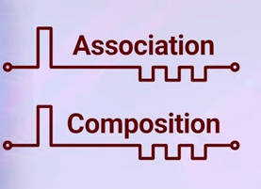
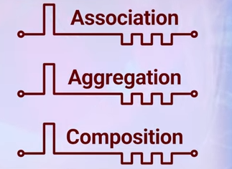
Relationship Basic Concepts Aggregation and Composition

